Slide 1
Putting the Issue into Perspective
By Charles Cooper
CRE 101
Section 29484
12/8/11

Slide 2
Issue
The social issue I decided to address is Poverty. Poverty is an ongoing problem in our society. Poverty is a social issue that is clearly defined by the four characteristics. Poverty impacts people all over the world on every continent and in every country. You can find poverty in a local setting, a societal setting, and even a global one. There are many factors that cause poverty for example, little to no education or lack of resources, and these affects run down communities, cause broken households, and the list can go on. Poverty can be documented by the use of data or even be observed in the field. So it is clear to see that poverty is a social issue. The social action I have decided to take to help reduce poverty is by volunteering at St. Vincent de Paul family dinner program. This directly relates to my social issue, which is poverty, because St. Vincent de Paul only feeds low income families, or families who live in poverty. Now of course there are different levels of poverty, but our state and city defines it as lower income families.

Slide 3
Personal Story
In my life I have never lived in poverty. I have been fortune enough that even though my parents got a divorce they both had jobs, a house, and were able to provide for us. So from a first person perspective I am unable to relate to living in poverty. The only thing I have to go on is what the media projects and my serve learning experiment at St. Vincent de Paul. The first time I walked into the cafeteria at St. Vincent you see the families you have the preconceived image of how they will look or act. I expected to see people who were unhealthy, below par hygiene, and not behaving. To my surprise I didn’t really see any of that. Sure I didn’t see a bunch of people in suits or dresses with there hair and makeup done up, but I did see people with descent clothes who were waiting patiently in line for the dinner to start. As for the people’s attitude, everyone for the most part was well behaved and there manners were considerably polite and what you except any where else. All the families who attend the dinner always say thank you and are very grateful that there are places like this that they can go to. I relived this is a very small portion of the poverty society ,but it goes to show you that you should always have an opened mind and more times then not you will be pleasantly surprised.

Slide 4
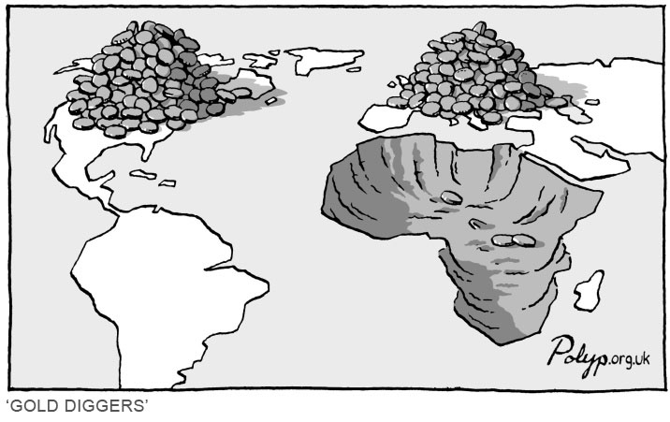
Cartoon
In the cartoon that I choose, the author is depicting poverty. The cartoon show a map of the world but in North American and Europe there are to big piles and Africa is just a big hole. You might just take from
http://www.polyp.org.uk/cartoons/wealth/polyp_cartoon_Africa.jpg
the cartoon that the author is trying to show how Africa is robbed of the resources by other countries. I think it goes deeper and the author in trying to show that poorer countries are bullied by richest country. Who come in and exploit poorer countries and thus increasing the poverty rate because those countries are being bought for a low rate and thus countries are losing money and are unable to support there on people. The cartoonist cartoon is an example of a connotation example of poverty.

Slide 5
Public Ad
The public serve announcement that I found it plays on the theme of five seconds. It first begins by listing off countries living in poverty. Then start to list off what happens in five seconds. The message that is trying to be promoted is that poverty can be cured by one person helping one another, and it doesn’t necessarily take an entire country, but can be cured by one person. The creator of this video uses a denotation approach in this public service announcement.
http://www.youtube.com/watch?v=RNK5pcoeA3o&feature=related

Slide 6
Video
The video I found is short but is to the point. In this video it focuses on defining poverty. The video hits you with images and definitions to really drive their point. The word choice is denotation because the video give definitions that use the literal meaning.
http://www.youtube.com/watch?v=GL-8HPdBroc

Slide 7
Statistic
“The increases in poverty levels from 2007 to 2010 were reflected in the state as a whole, where at least 1.1 million Arizonans, or 17.6 percent, were living in poverty in 2010. That was an increase from 14.1 percent in 2007.”
Counties | Coconino | Maricopa | Yuma
Year
2007 | 16.2 | 12.9 | 17.8
2010 | 23.8 | 16.6 | 21.1
http://www.yumasun.com/news/percent-74955-poverty-county.html

Slide 8
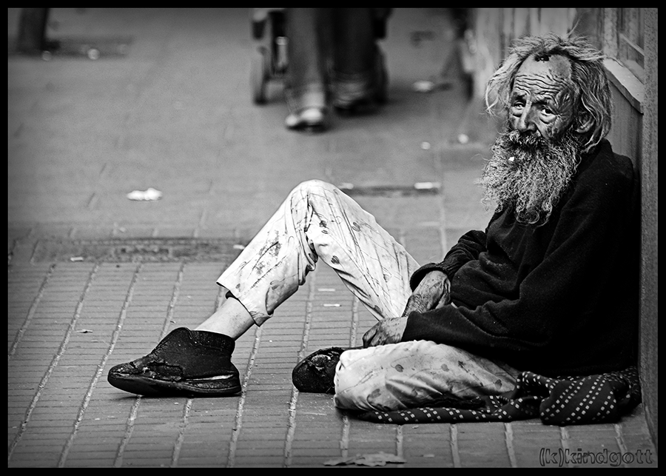
Photograph
I choose this picture because I feel it resents what people perceive as poverty. Poverty is captured in this photograph, but poverty comes in many forms. You may not see people like this man in your neighborhoods, but I'm sure you have seen a family that has a child with a disability and the parents work for minimum wage who can’t afford their medical bills.
You may know someone who has been laid off recently and that has cause them to lose there house and become delinquent with their bills which now has to rely on government assistance. The author is showing an denotation example of poverty, but in my opinion all he shows is a small portion of poverty. The photographer is showing the top layer of poverty.
http://www.flickr.com/photos/dante1334/2625370697/sizes/o/

Slide 9
Conclusion
I feel that St.Vincent de Paul provides a wonderful serve to the community and by all means pulls their own weight when it comes to giving back to the families and nearby communities. On the other hand I think they have more of a prison cycle mentality because these families who attend the dinner, thrift stores, housing unit, etc. aren’t really working to get them out of poverty they are just living more comfortably in poverty. Now sure, there are a handful of people who are only there for short period of time, and then there are some that need to have program like that to survive. But I feel there is an overwhelming amount of people who are just there for the ride. If St. Vincent de Paul wasn’t there what would those families do? I feel that St. Vincent, like the other nonprofit organization, should do more to work towards giving people or families living in poverty the skills and resources to be self sufficient rather than dependent of St. Vincent de Paul or other organizations.

Slide 10
References
Cartoon. http://www.polyp.org.uk/cartoons/wealth/polyp_cartoon_Africa.jpg. Retrieved 12/2/11
Six Arizona Counties Show Poverty Increase. http://www.yumasun.com/news/percent-74955-poverty-county.html. Retrieved 12/2/11
Press Release Pivot. http://www.pressreleasepivot.com/6253/free-omelet-day-to-benefit-struggling-families-in-phoenix. Retrieved 12/1/11
Every 5 Seconds. http://www.youtube.com/watch?v=RNK5pcoeA3o&feature=related. Retrieved 12/5/11
What is Poverty?. http://www.youtube.com/watch?v=GL-8HPdBroc. Retrieved 12/4/11
Flickr. http://www.flickr.com/photos/dante1334/2625370697/sizes/o/. Retrieved 12/7/11

