Slide 1
Teen Pregnancy
CRE 101
Section 29484
By Charles Cooper
11/29/11

Slide 2
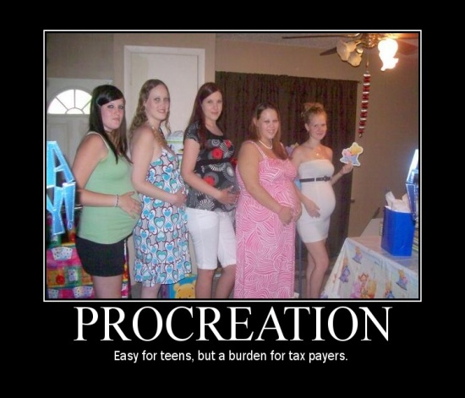
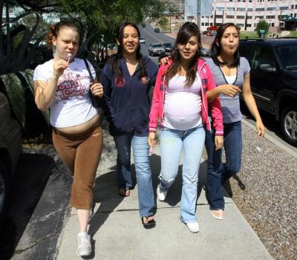
Introduction
About 750,000 teens get pregnant in the United States each year. An alarming epidemic that is sweeping the United States besides obesity, unemployment, and a falling housing industry, is teen pregnancy. Teen Pregnancy is costing the United States nine billion dollars each year and not to mention it is increasing an already over populated world we live in. By educating our kids and providing them with the proper resources, we can help to reduce teenage pregnancy in the world.
http://cltampa.com/dailyloaf/archives/2010/01/28/
http://shelleytheradiolady.com/?p=356
http://www.dosomething.org/tipsandtools/11-facts-about-teen-pregnancy

Slide 3
Personal Story
In my family we have only had a cousin get pregnant in her teens. She wasn’t and still isn’t a bad kid she just made a bad choice. She was just like every other teenager out there. Her mind set was that it couldn’t happen to her. She grew up with two other sisters and was raised by a single mom. She is the oldest of the three girls. As her mom had to work long days, which always turned into late night she became the mom of the household. She was the one who helped her sisters with their school work, she was the one who made dinner, and she was the one who took on the role of a mother. Now, there mom was always there for them, just not physically because she was trying to support a full house that would soon become fuller. As my cousin became interested in boys, soon there were consequences to that interest. Soon another member of the Cooper family was born. Unfortunately, like a majority of teen pregnancy they spilt up and are no longer together. The positive spin is that my cousin has a beautiful little girl and will soon be getting married to a man that has two kids of his own.

Slide 4
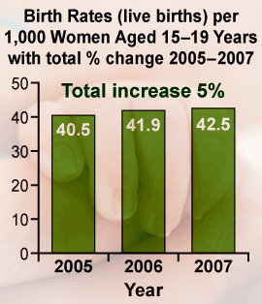
How does teen pregnancy affect your education?
“Pregnancy and birth are significant contributors to high school drop out rates among girls. Only about 50% of teen mothers receive a high school diploma by age 22, versus nearly 90% of women who had not given birth during adolescence” (cdc.gov).
http://jadebt13.edublogs.org/
http://www.guttmacher.org/pubs/USTPtrends.pdf

Slide 5
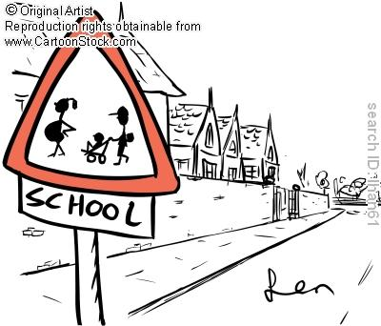
Cartoon
The cartoon I found is depicting a school cross walk sign, but this is not your typical cross walk sign. In the sign you have your children walking across ,but the female child is pregnant and the male with is wearing a backpack and pushing a kid is the stroller. The message behind this cartoon is connotation because it is depicting the raising of pregnant kids in schools.

Slide 6
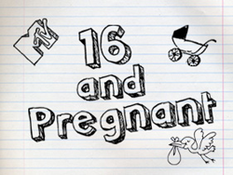
Does the Media make teen pregnancy acceptable?
http://en.wikipedia.org/wiki/Teen_Mom
http://en.wikipedia.org/wiki/16_and_Pregnant
http://www.imdb.com/title/tt0467406/
Shows and movies are popping up left and right on television
http://www.youtube.com/watch?v=bnHSnlhZ2ZA

Slide 7
Photograph
Here is a photograph of Bristol Palin and her baby on the cover of one of the top magazine. I feel that the message being promote here is that it is ok to be a teen mom. That if you become a teen mom then you can be on the cover of magazines. What young moms aren’t seeing is the negative side of being pregnant. I feel that this photograph is promoting a denotation image of a teen mom, even through I don’t feel that it is a real image of a mom, the magazine is try to promote that perfect image.
https://jerkmag.wordpress.com/2010/04/08/bristol-palin-preaches-pregnancy-for-the-privileged-only/

Slide 8
How does your socioeconomic status affect your likely hood of getting pregnancy.
Among non-Hispanic white teenagers, the pregnancy rate declined 50% in the same period(from 86.6 per 1,000 to 43.3), before increasing to 44.0 in 2006.2
Among black women aged 15–19, the nationwide pregnancy rate fell by 45% (from 223.8 per 1,000 to 122.7) between 1990 and 2005, before increasing to 126.3 in 2006.
Among Hispanic teenagers (of any race), the pregnancy rate decreased by 26% (from 169.7 per 1,000 to 124.9) between 1992 and 2005, before rising to 126.6 in 2006.
“Socioeconomic status is a factor to whether or not pregnancy will be an issue. Psychology Today notes that a girl who lives in poverty is more likely to become pregnant because of teachings and attitudes on sex, as well as access to contraception. A teen who has been in the foster care system is also more likely to become pregnant before the age of 19. While not all parents and teachers can alter a teen”. http://www.livestrong.com/article/163803-factors-affecting-early-teenage-pregnancy/

Slide 9
Public Ad
http://www.youtube.com/watch?v=E1PH3VBJFh4
Here is a public serves announcement I found. It is a great advertisement because it depicts a real situation and it doesn’t show a glamorous life style. It shows two teen who made a choice that has catastrophic consequences. It shows one version of a males point of view and the females. The message behind this ad is denotation.

Slide 10
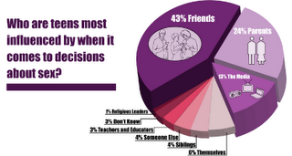
Should school do more to inform kids of getting pregnant?
“Providing basic information provides the foundation on which more complex knowledge is built up over time.”
“Attempts to impose narrow moralistic views about sex and sexuality on young people through sex education have failed.”
http://www.avert.org/sex-education.htm
http://urbanyouthsos.blogspot.com/

Slide 11
Conclusion
As you can clearly see from this PowerPoint teen pregnancy is an epidemic, but an epidemic that can be reduced. Teen pregnancy is a growing epidemic in our world and by educating our youth and providing them with the right resources we can help reduce this growing problem. The power of knowledge has been far underrated, children are our future and by raising our kids with knowledge about the problem they may make better decisions for themselves.
http://www.uccsda.org/familylife
http://mcdonaldsdollarmenu.com/

Slide 12
Bibliography
IMDB Juno. http://www.imdb.com/title/tt0467406/. Retrieved 10/26/11
U.S. Teenage Pregnancies, Births and Abortions: National and State Trends and Trends by Race and Ethnicity. http://www.guttmacher.org/pubs/USTPtrends.pdf. Retrieved 10/27/11
Celebrity Through Pregnancy? http://jadebt13.edublogs.org/. Retrieved 10/27/11
http://www.cdc.gov/teenpregnancy/AboutTeenPreg.htm. Retrieved 10/27/11
http://www.livestrong.com/article/163803-factors-affecting-early-teenage-pregnancy/. Retrieved 10/29/11
Sex Education that Works. http://www.avert.org/sex-education.htm. Retrieved 10/29/11
http://www.dosomething.org/tipsandtools/11-facts-about-teen-pregnancy. Retrieved 11/29/11
http://www.cartoonstock.com/directory/t/teen_pregnancy.asp. Retrieved 11/29/11
https://jerkmag.wordpress.com/2010/04/08/bristol-palin-preaches-pregnancy-for-the-privileged-only/. Retrieved 11/29/11
Teen Pregnancy PSA: directed by Sheldon Candis. http://www.youtube.com/watch?v=E1PH3VBJFh4. Retrieved 11/30/11

