Slide 1
Service Learning Project
By Charles Cooper
CRE 101
Section 29484
12/6/11

Slide 2
My issue
After searching countless sites and calling many originations, I came across St.Vincent de Paul
My issue is poverty. Poverty is an on going epidemic in of world today. When this class started and we had to pick an organization to become involved with I didn’t want to spend my time not really making a difference. So I took a week to really think about, “where can I make the biggest differences?”

Slide 3
St. Vincent de Paul
“The Society of St. Vincent de Paul is an international non-profit organization dedicated to serving the poor and providing others with the opportunity to serve. The Phoenix Diocesan Council has been assisting central and northern Arizona families since 1946. Programs include services for the homeless, medical and dental care for the working poor, charity dining rooms, thrift stores, a transitional housing shelter and general assistance for individuals in need.”

Slide 4
My Story
I have always wanted to volunteer in my community, but I have never really had the time or drive to do so. Once in the past I volunteered at Paz de Cristo and it was a great experience. So in this class I was planning on doing the same thing, but do to too many volunteer Paz de Cristo didn’t have any room. My next organization I looked into was Meals on Wheel, but do to a lack of communication I never heard back. Finally I came upon St. Vincent de Paul, and luckily they were happy to let me volunteer with them. The first person I contacted was Mike. Mike is one of the volunteer coordinators. Mike was very helpful with addressing what I was looking for and working with my school and work schedule. My schedule at St. Vincent was pretty easy except for when I went in on Thursday. The problem was when I went in they had to many volunteers so they didn’t really have anything for me to do. I decided to just volunteer on Mondays, which is when they needed the most help anyways. On Monday I was helping out in the cafeteria where we served the family dinners. As I became more and more familiar with the process I became more and more comfortable with the people. Along the way I met some great people both who attend the family meal and those who volunteer or work in the cafeteria. This experience is one I with never forget and I look forward to continuing my services with St. Vincent de Paul.

Slide 5
My Service Learning Activities
Jobs
Descriptions
Serving
Greeting
Processing
Expediting
Consisting of taking orders and then delivering them to the families
Sitting the Families when they arrive
Orders are bought to the processor at the hot station and then he/she will read them off to the people working the hot station
This is the person who places the hot plates and then makes sure orders are complete for the servers

Slide 6
My Service Learning Continued
Jobs
Description
Hot Station
Salad Bar
Setting up
Cleaning up
Every family gets a hot plate which consists of one entrée, two sides, slice of bread, and a cookie
The salad bar has typically items that the family are allowed to choose from, which are served to them by the volunteers
Setting up involves getting all the table stocked with silverware, salt and pepper, a pitcher of juice and water, and a table number.
Cleaning up involves sweeping floors, wiping down tables and work areas, breaking down the salad bar, and taking out the trash.

Slide 7
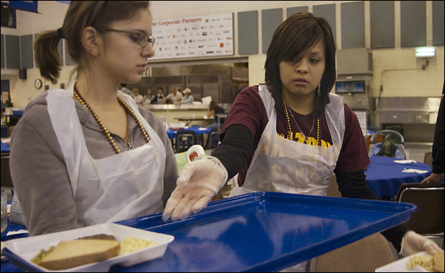
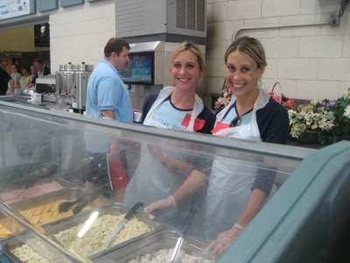
My Photograph

Slide 8
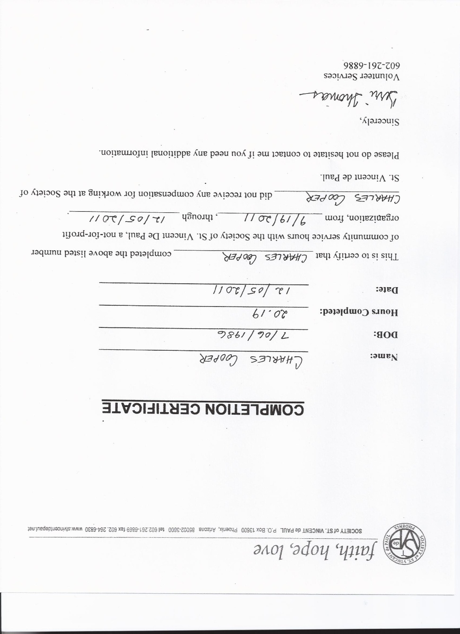
My Completion
After completing my twenty hours, I know have a new found perspective on how fortunate my life is even though it doesn’t always seem that way. Although, I feel St. Vincent de Paul could do more to cure poverty, they still provide a service that helps them in a time of need. St. Vincent does what they can with the little donation that they receive. My experience has showed me that you don’t need a lot to make a big difference in people lives. All you need is hope and a lot of good people who are willing to make a difference.

Slide 9
References
Society of St.Vincent de Paul http://www.stvincentdepaul.net/index.htm. Retrieved 12/1/11

